Slide 1
Machine Learning Practice
7. Improving Deep NNs

Slide 2
References
Andrew Ng’s ML class
https://class.coursera.org/ml-003/lecture
http://www.holehouse.org/mlclass/ (note)
Convolutional Neural Networks for Visual Recognition.
http://cs231n.github.io/
Tensorflow
https://www.tensorflow.org
https://github.com/aymericdamien/TensorFlow-Examples
모두의 머신러닝
Wikipedia
Neural Network and Deep Learning, Michael Nielsen,
http://neuralnetworksanddepplearning.com

Slide 3
Applied ML is a highly iterative process
#layers
#hidden units
Learning rate
Activation functions
…
Idea → code → experiment → idea → …

Slide 4
Training/validation/test set
Traditionally, the training data is split into 3 groups.
Training set, hold-out (cross validation set), test set
Previous era
70/30, or 60/20/20 was considered as the best practice
#training example ranges from 100 to 10,000
Big data era
If we have e.g. 1,000,000 examples,
Validation set tends to become smaller
98/1/1 would be good enough
Make sure that the validation and test set come from the same distribution
Not having a test set might be okay (only validation set)

Slide 5
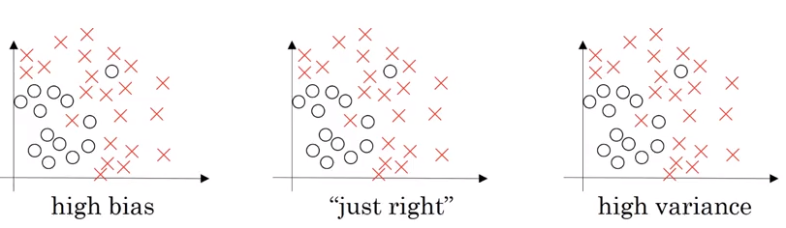
Bias and Variance
Underfiting
Overfiting
In statistics and machine learning, the bias–variance tradeoff (or dilemma) is the problem of simultaneously minimizing two sources of error that prevent supervised learning algorithms from generalizing beyond their training set:[Wikipedia]
The bias is an error from erroneous assumptions in the learning algorithm. High bias can cause an algorithm to miss the relevant relations between features and target outputs (underfitting).
The variance is an error from sensitivity to small fluctuations in the training set. High variance can cause an algorithm to model the random noise in the training data, rather than the intended outputs (overfitting).

Slide 6
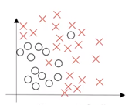
Bias and Variance
Assume that human’s error (base error) is around 0%
Binary classification
Train set error : 1% Validation set error 11%
→ High variance
Train set error : 15% Validation set error 16%
→ High bias
Train set error : 15% Validation set error 30%
→ High bias & High variance
Train set error : 0.5% Validation set error 1%
→ low bias & low variance
High bias & high variance

Slide 7
Basic recipe for ML
High bias?
(training data performance)
Yes
Try bigger network
Train longer,
(NN architecture search)
No
High variance?
(validation data perf.)
Yes
Try more data
Apply regularization
(NN architecture search)
Done
Depending on whether you have a bias or variance problem, the set of things you should try could be different. For example, if you have a high bias problem, getting more data will not help

Slide 8
Basic recipe for ML
In the earlier era of machine learning, there used to be a lot of discussion on what is called the bias variance tradeoff.
Back in the pre-deep learning era, we didn't have as many tools that just reduce bias or that just reduce variance without hurting the other one.
in the modern deep learning era, for example, getting a bigger network almost always just reduces your bias without necessarily hurting your variance, so long as you regularize appropriately.
And getting more data pretty much always reduces your variance problem without hurting the bias much.

Slide 9
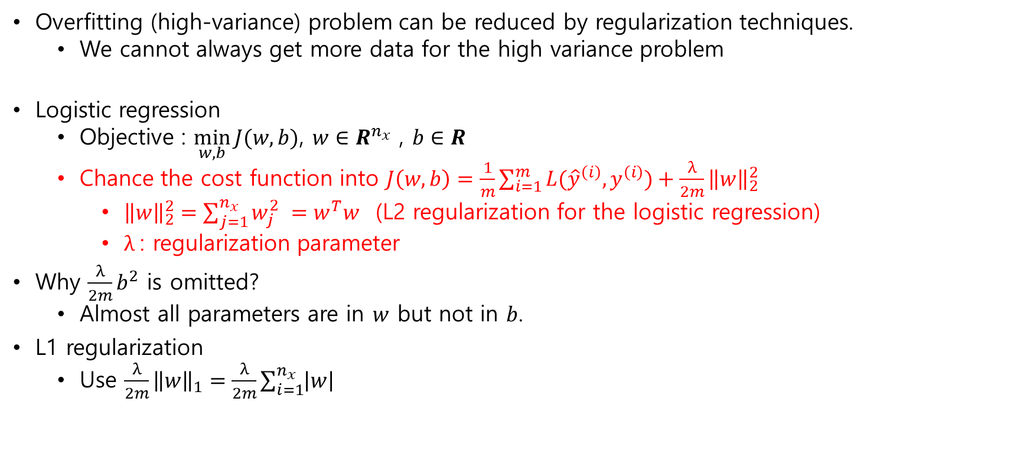
Regularization for logistic regression
Overfitting (high-variance) problem can be reduced by regularization techniques.
We cannot always get more data for the high variance problem
Logistic regression
Objective : $\min_{w,b}{J(w,b)}$, $w∈R^{n_{x}}$ , $b∈R$
Chance the cost function into $J\left(w,b\right)=\frac{1}{m}\sum_{i=1}^{m}{L({\hat{y}}^{\left(i\right)},y^{\left(i\right)})}+\frac{λ}{2m}{\left\|w\right\|}_{2}^{2}$
${\left\|w\right\|}_{2}^{2}=\sum_{j=1}^{n_{x}}{w_{j}^{2} }=w^{T}w$ (L2 regularization for the logistic regression)
$λ$: regularization parameter
Why $\frac{λ}{2m}b^{2}$ is omitted?
Almost all parameters are in $w$ but not in $b$.
L1 regularization
Use $\frac{λ}{2m}{\left\|w\right\|}_{1}=\frac{λ}{2m}\sum_{i=1}^{n_{x}}{\left|w\right|}$

Slide 10
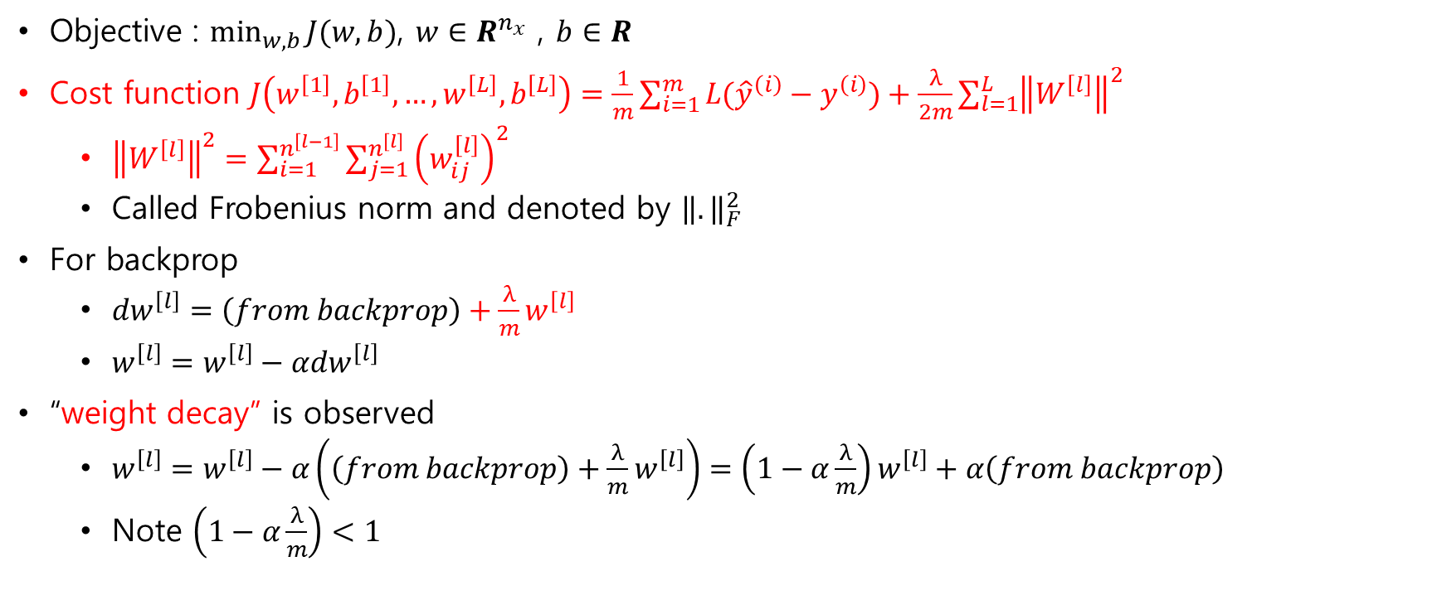
Regularization for NNs
Objective : $\min_{w,b}{J(w,b)}$, $w∈R^{n_{x}}$ , $b∈R$
Cost function $J\left(w^{\left[1\right]},b^{\left[1\right]},…,w^{\left[L\right]},b^{\left[L\right]}\right)=\frac{1}{m}\sum_{i=1}^{m}{L({\hat{y}}^{\left(i\right)}−y^{\left(i\right)})}+\frac{λ}{2m}\sum_{l=1}^{L}{{\left\|W^{\left[l\right]}\right\|}^{2}}$
${\left\|W^{\left[l\right]}\right\|}^{2}=\sum_{i=1}^{n^{\left[l−1\right]}}{\sum_{j=1}^{n^{\left[l\right]}}{{\left(w_{ij}^{\left[l\right]}\right)}^{2}}}$
Called Frobenius norm and denoted by ${\left\|.\right\|}_{F}^{2}$
For backprop
$dw^{\left[l\right]}=\left(from backprop\right)+\frac{λ}{m}w^{\left[l\right]}$
$w^{\left[l\right]}=w^{\left[l\right]}−αdw^{\left[l\right]}$
“weight decay” is observed
$w^{\left[l\right]}=w^{\left[l\right]}−α\left(\left(from backprop\right)+\frac{λ}{m}w^{\left[l\right]}\right)=\left(1−α\frac{λ}{m}\right)w^{\left[l\right]}+α\left(from backprop\right)$
Note $\left(1−α\frac{λ}{m}\right)<1$

Slide 11
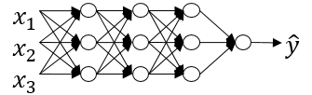
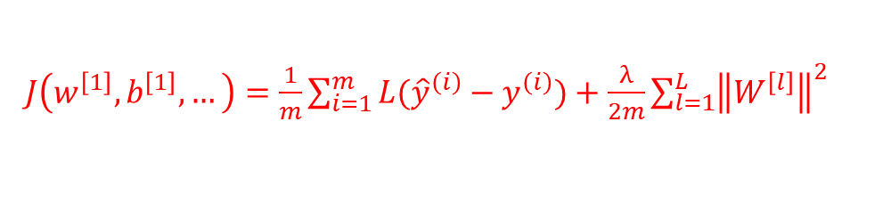
How does regularization reduces overfitting?
$J\left(w^{\left[1\right]},b^{\left[1\right]},…\right)=\frac{1}{m}\sum_{i=1}^{m}{L({\hat{y}}^{\left(i\right)}−y^{\left(i\right)})}+\frac{λ}{2m}\sum_{l=1}^{L}{{\left\|W^{\left[l\right]}\right\|}^{2}}$
Intuitive reason 1. Assume a big $λ$. Then it causes $W^{\left[l\right]}$ to be close to 0. It could almost zero out a lot of the impact of the hidden units and simplify the whole network.
Intuitive reason 2. Small $W^{\left[l\right]}$ makes $z^{\left[l\right]}$ to be in the linear range of the activation function (e.g., tanh())

Slide 12
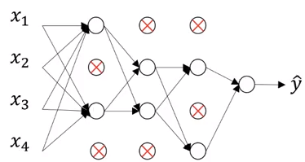
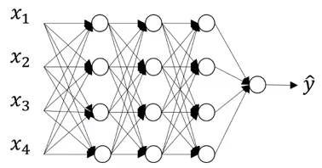
Dropout regularization
0.5
0.5
0.5
For each layer, we eliminate nodes based on a certain probability. It provides us with a smaller network.

Slide 13
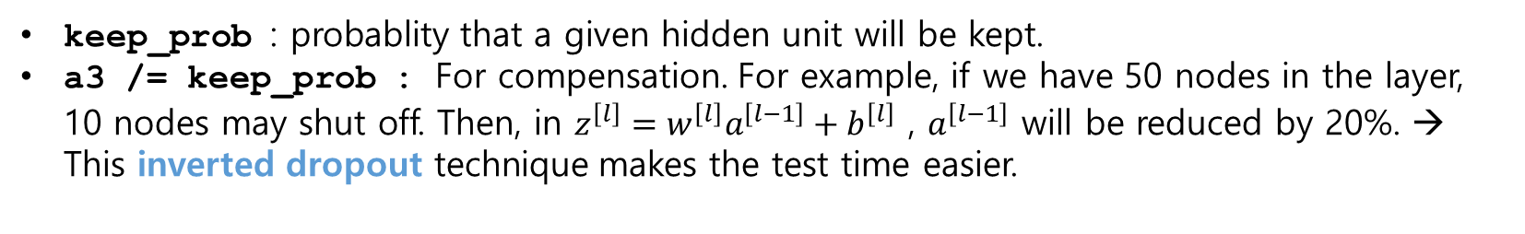
Implementation (Inverted dropout)
Assume that we have 3rd layer for dropout
keep_prob = 0.8
d3 = np.random.rand( a3.shape[0], a3.shape[1] ) < keep_prop # d3 is a Boolean matrix
a3 = np.multiply( a3, d3 )
a3 /= keep_prob
keep_prob : probablity that a given hidden unit will be kept.
a3 /= keep_prob : For compensation. For example, if we have 50 nodes in the layer, 10 nodes may shut off. Then, in $z^{\left[l\right]}=w^{\left[l\right]}a^{\left[l−1\right]}+b^{\left[l\right]}$ , $a^{\left[l−1\right]}$ will be reduced by 20%. → This inverted dropout technique makes the test time easier.

Slide 14

Implementation at test time
$a^{\left[0\right]}=X$
No dropout is used
$z^{\left[1\right]}=W^{\left[1\right]}a^{\left[0\right]}+b^{\left[1\right]}$
$a^{\left[1\right]}=g^{\left[0\right]}\left(z^{\left[1\right]}\right)$
$z^{\left[2\right]}=W^{\left[2\right]}a^{\left[1\right]}+b^{\left[2\right]}$
$…$
a3 /= keep_prob : ensures that even when you don’t implement dropout at test time, the expected value of the activations do not chance.

Slide 15
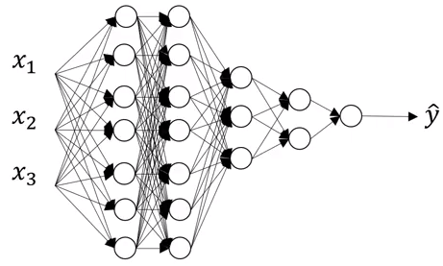
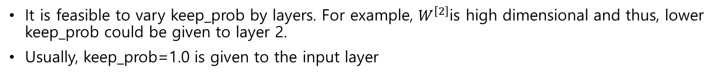
Why dropout works?
Intuition: the blue node does not rely on any one feature, so have to spread out weights. It tends to have an effect of shrinking the squared norm of the weights
It is feasible to vary keep_prob by layers. For example, $W^{\left[2\right]}$is high dimensional and thus, lower keep_prob could be given to layer 2.
Usually, keep_prob=1.0 is given to the input layer

Slide 16
Other tips
If you do not suffer from over-fitting, don’t bother to use dropout.
For example with the computer vision area, we usually don't have enough data, and almost always suffer form overfitting. Thus, they frequently tends to use drop out.
One big downside of drop out is that the cost function J is no longer well-defined. On every iteration, you are randomly killing off a bunch of nodes. Because the cost function J not well defined, it is hard to obtain J that monotonically decrease over every iteration.
At debugging, you want to turn off drop out by setting keep_prop to one and you run the code and make sure that it is monotonically decreasing J, and then turn on drop out

Slide 17



Other regularization techniques
Data augmentation : add more generated data into the training set
It is not as good as collecting an additional set of independent examples. But it does not need any additional effort to collect new images.
Rotation, zooming, etc. could generate more examples

Slide 18
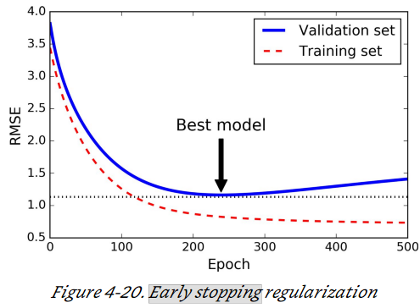
Early stopping
With early stopping you just stop training as soon as the validation error reaches the minimum. It is such a simple and efficient regularization technique that Geoffrey Hinton called it a “beautiful free lunch.”
Downside
We have two objectives, (1) optimizing the cost function J and (2) not overfitting.
(1) and (2) should be separate → Orthogonalization
Early stopping couples (1) and (2). In other words, by stopping optimization, it resolves the overfitting.
Recommend to use L2 regularization at the expense of computation (more hyperparameters)

Slide 19
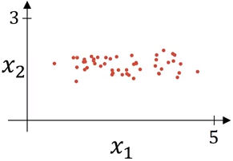
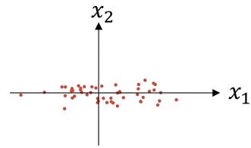
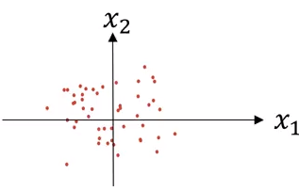
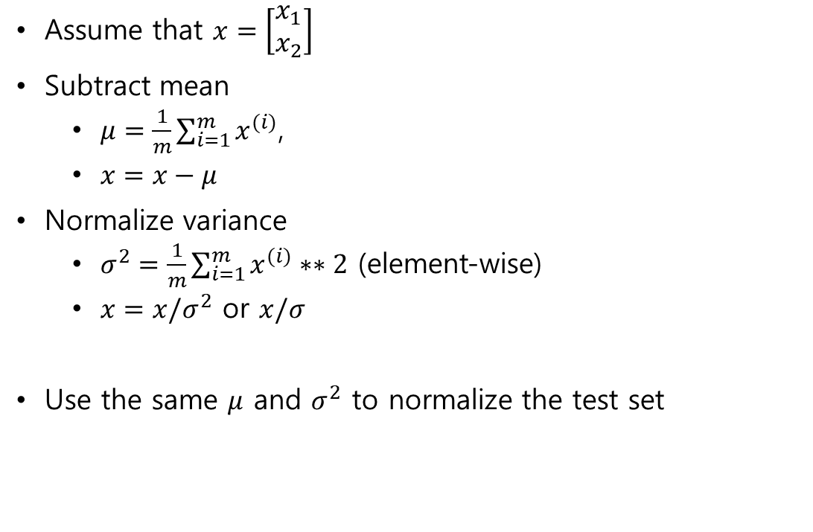
Normalizing training sets
Assume that $x=\left[\begin{matrix}x_{1} \\ x_{2}\end{matrix}\right]$
Subtract mean
$μ=\frac{1}{m}\sum_{i=1}^{m}{x^{(i)}}$,
$x=x−μ$
Normalize variance
$σ^{2}=\frac{1}{m}\sum_{i=1}^{m}{x^{(i)}∗∗2}$ (element-wise)
$x=x/σ^{2}$ or $x/σ$
Use the same $μ$ and $σ^{2}$ to normalize the test set

Slide 20
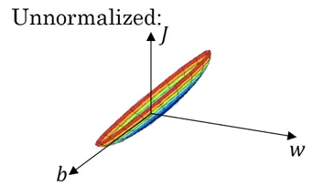
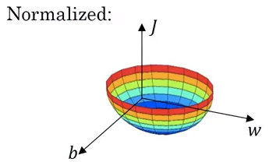
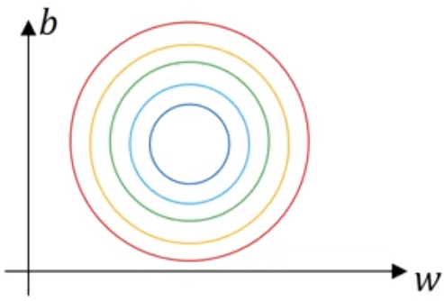
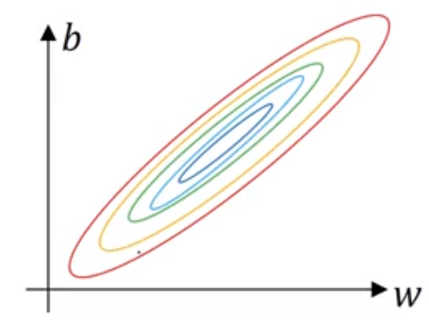
Why normalize inputs?
If x1 and x2 have very different ranges of values, then the corresponding w1 and w2 have different ranges of values too.
The learning rate for the curve of the unnormalized inputs can be restricted to be small

Slide 21
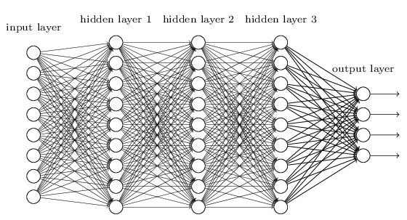
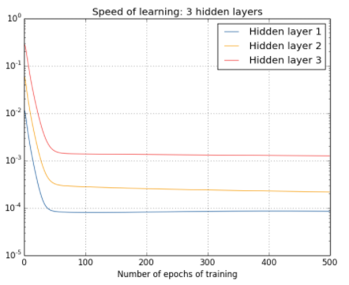
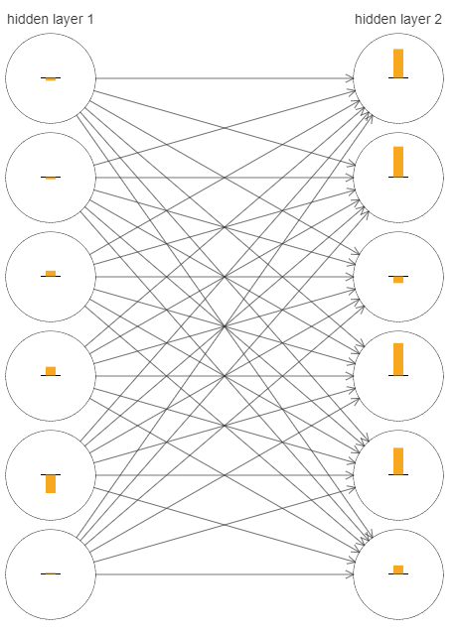

Vanishing/exploding gradients → unstable gradient problem
We roughly measure the speed of learning by the length of the vector $\frac{∂J}{∂w^{l}}$

Slide 22

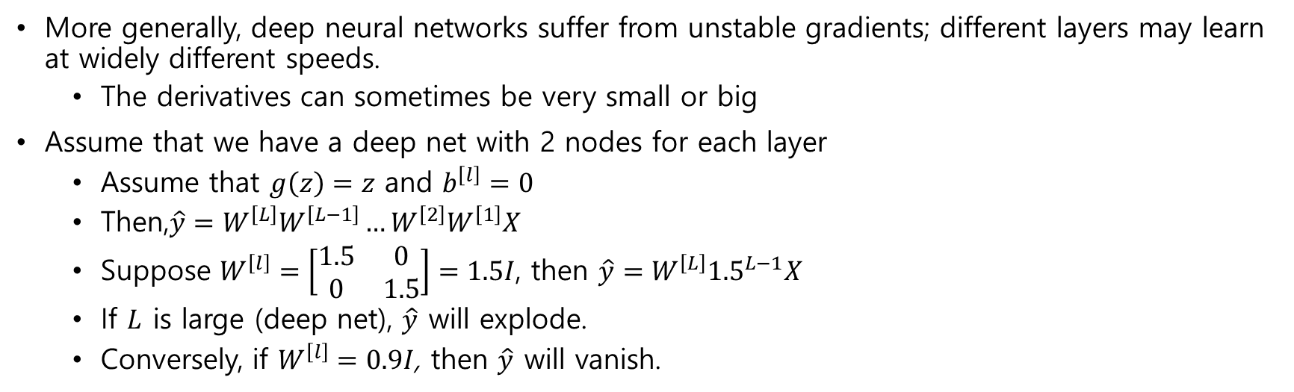
Vanishing/exploding gradients → unstable gradient problem
More generally, deep neural networks suffer from unstable gradients; different layers may learn at widely different speeds.
The derivatives can sometimes be very small or big
Assume that we have a deep net with 2 nodes for each layer
Assume that $g\left(z\right)=z$ and $b^{\left[l\right]}=0$
Then,$\hat{y}=W^{\left[L\right]}W^{\left[L−1\right]}…W^{\left[2\right]}W^{\left[1\right]}X$
Suppose $W^{\left[l\right]}=\left[\begin{matrix}1.5 & 0 \\ 0 & 1.5\end{matrix}\right]=1.5I$, then $\hat{y}=W^{\left[L\right]}{1.5}^{L−1}X$
If $L$ is large (deep net), $\hat{y}$ will explode.
Conversely, if $W^{\left[l\right]}=0.9I$, then $\hat{y}$ will vanish.

Slide 23
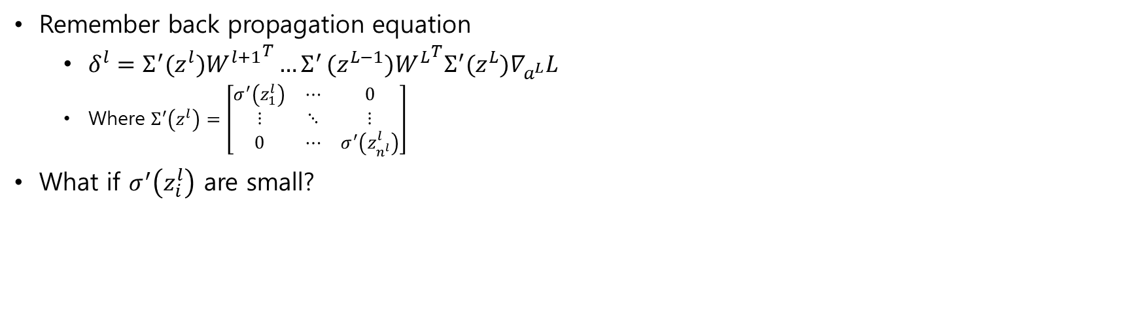
Vanishing/exploding gradients → unstable gradient problem
Remember back propagation equation
$δ^{l}=Σ^{′}(z^{l}){W^{l+1}}^{T}{…Σ}^{′}(z^{L−1}){W^{L}}^{T}Σ^{′}(z^{L})∇_{a^{L}}L$
Where $Σ^{′}\left(z^{l}\right)=\left[\begin{matrix}σ^{′}\left(z_{1}^{l}\right) & ⋯ & 0 \\ ⋮ & ⋱ & ⋮ \\ 0 & ⋯ & σ^{′}\left(z_{n^{l}}^{l}\right)\end{matrix}\right]$
What if $σ^{′}\left(z_{i}^{l}\right)$ are small?

Slide 24
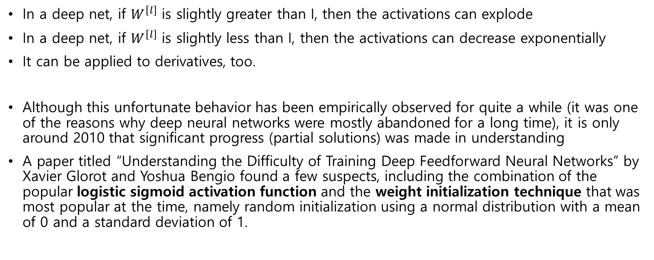
Vanishing/exploding gradients → unstable gradient problem
In a deep net, if $W^{\left[l\right]}$ is slightly greater than I, then the activations can explode
In a deep net, if $W^{\left[l\right]}$ is slightly less than I, then the activations can decrease exponentially
It can be applied to derivatives, too.
Although this unfortunate behavior has been empirically observed for quite a while (it was one of the reasons why deep neural networks were mostly abandoned for a long time), it is only around 2010 that significant progress (partial solutions) was made in understanding
A paper titled “Understanding the Difficulty of Training Deep Feedforward Neural Networks” by Xavier Glorot and Yoshua Bengio found a few suspects, including the combination of the popular logistic sigmoid activation function and the weight initialization technique that was most popular at the time, namely random initialization using a normal distribution with a mean of 0 and a standard deviation of 1.

Slide 25
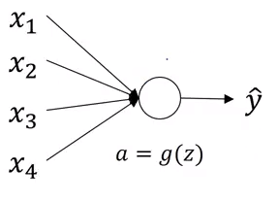
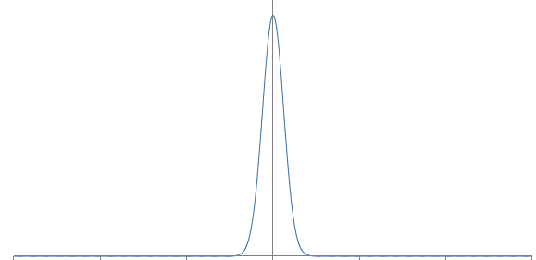
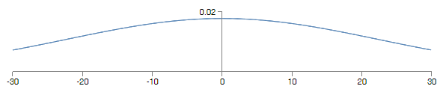
Weight initialization for deep NNs : single neuron example
Assume that x and w are initialized with N(0,1).
When #input is small,
When #input is 500,
w
z
z

Slide 26
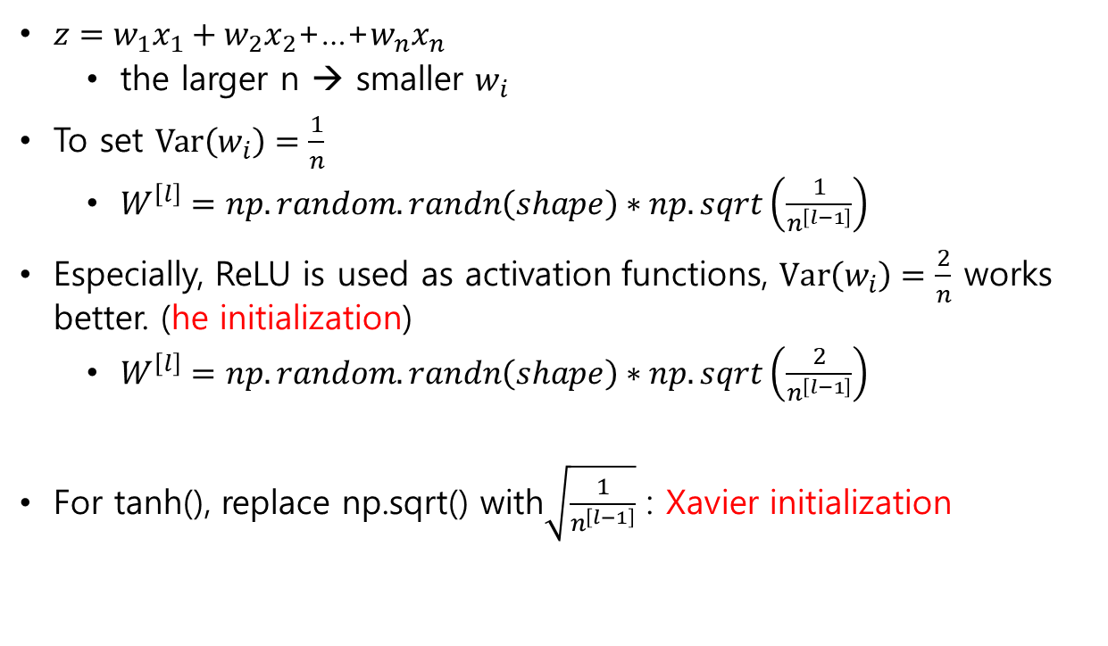
Weight initialization for deep NNs : single neuron example
$z=w_{1}x_{1}+w_{2}x_{2}$+…+$w_{n}x_{n}$
the larger n → smaller $w_{i}$
To set $Var\left(w_{i}\right)=\frac{1}{n}$
$W^{\left[l\right]}=np.random.randn\left(shape\right)∗np.sqrt\left(\frac{1}{n^{\left[l−1\right]}}\right)$
Especially, ReLU is used as activation functions, $Var\left(w_{i}\right)=\frac{2}{n}$ works better. (he initialization)
$W^{\left[l\right]}=np.random.randn\left(shape\right)∗np.sqrt\left(\frac{2}{n^{\left[l−1\right]}}\right)$
For tanh(), replace np.sqrt() with$\sqrt{\frac{1}{n^{\left[l−1\right]}}}$ : Xavier initialization
He. et al., “Delving Deep into Rectifiers: Surpassing Human-Level Performance on ImageNet Classification”, 2015

Slide 27
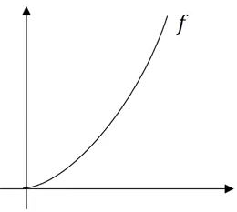
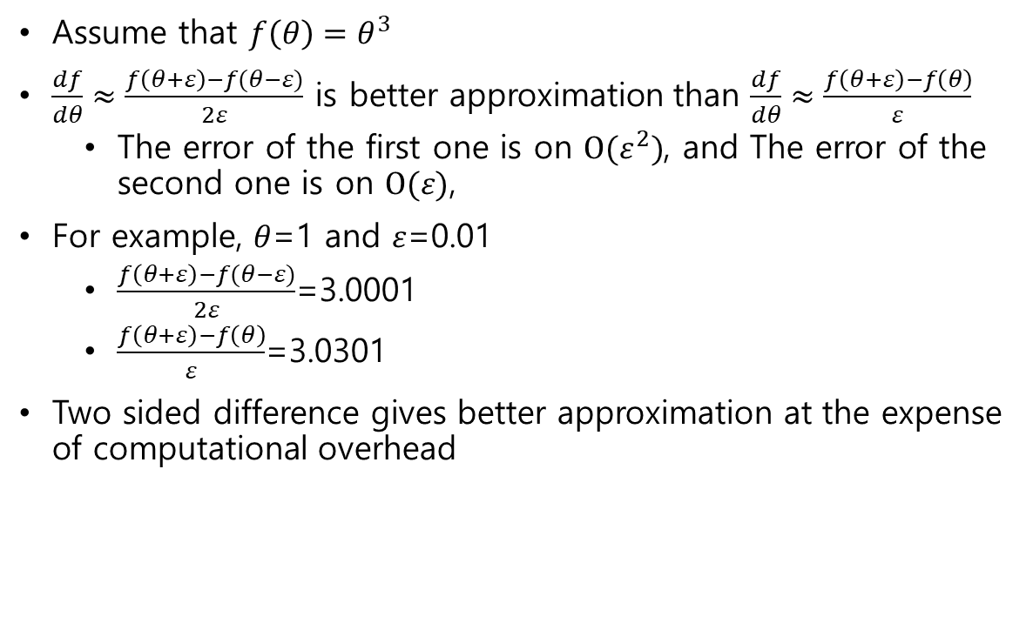
(optional) Numerical approximation of gradient
Assume that $f\left(θ\right)=θ^{3}$
$\frac{df}{dθ}≈\frac{f\left(θ+ε\right)−f(θ−ε)}{2ε}$ is better approximation than $\frac{df}{dθ}≈\frac{f\left(θ+ε\right)−f\left(θ\right)}{ε}$
The error of the first one is on $O(ε^{2})$, and The error of the second one is on $O(ε)$,
For example, $θ$=1 and $ε$=0.01
$\frac{f\left(θ+ε\right)−f(θ−ε)}{2ε}$=3.0001
$\frac{f\left(θ+ε\right)−f\left(θ\right)}{ε}$=3.0301
Two sided difference gives better approximation at the expense of computational overhead

Slide 28
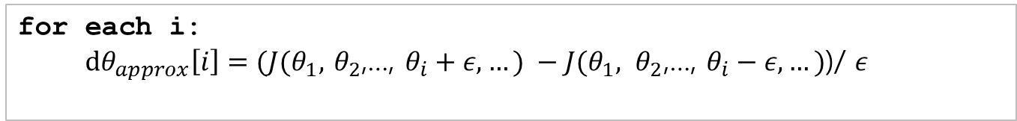
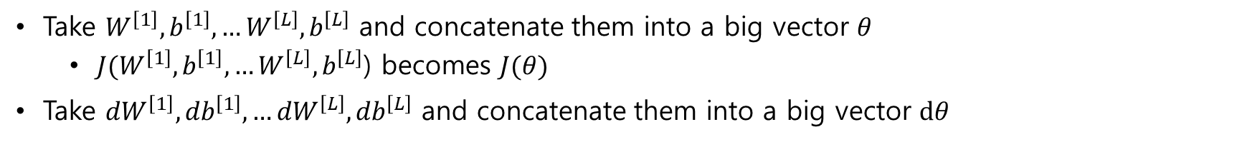
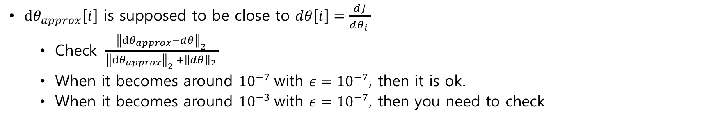
(optional) Gradient checking for debugging your backprop.
Take $W^{\left[1\right]},b^{\left[1\right]},…W^{\left[L\right]},b^{\left[L\right]}$ and concatenate them into a big vector $θ$
$J(W^{\left[1\right]},b^{\left[1\right]},…W^{\left[L\right]},b^{\left[L\right]}$) becomes $J(θ)$
Take ${dW}^{\left[1\right]},{db}^{\left[1\right]},…{dW}^{\left[L\right]},{db}^{\left[L\right]}$ and concatenate them into a big vector $dθ$
for each i:
$dθ_{approx}\left[i\right]=(J(θ_{1},$ $θ_{2}$,…, $θ_{i}+ε,…) −J(θ_{1}, θ_{2}\text{,}\text{…}\text{, }θ_{i}−ε,…)$)/ $ε$
$dθ_{approx}\left[i\right]$ is supposed to be close to $dθ\left[i\right]=\frac{dJ}{dθ_{i} }$
Check $\frac{{\left\|dθ_{approx}−dθ\right\|}_{2} }{{\left\|dθ_{approx}\right\|}_{2} +{\left\|dθ\right\|}_{2} }$
When it becomes around ${10}^{−7}$with $ε={10}^{−7}$, then it is ok.
When it becomes around ${10}^{−3}$with $ε={10}^{−7}$, then you need to check

Slide 29
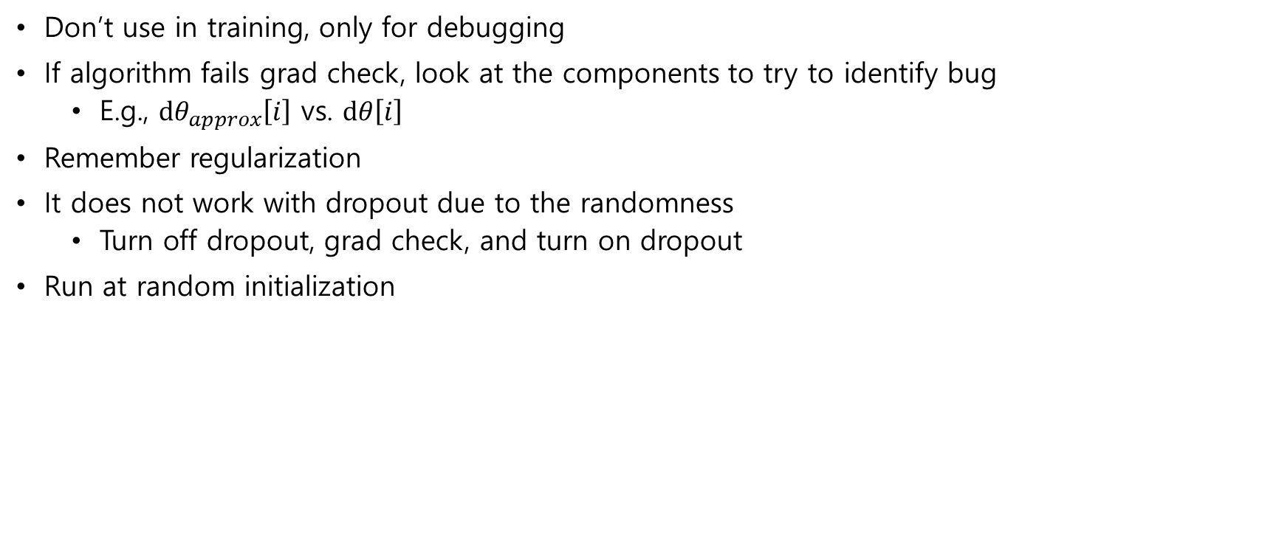
(optional) Gradient checking implementation
Don’t use in training, only for debugging
If algorithm fails grad check, look at the components to try to identify bug
E.g., $dθ_{approx}\left[i\right]$ vs. $dθ\left[i\right]$
Remember regularization
It does not work with dropout due to the randomness
Turn off dropout, grad check, and turn on dropout
Run at random initialization

